Slide 1
Welcome to Leeway School!

Slide 2
This is my new school!

Slide 3
I will take the bus to school and a staff member will walk me to my classroom.

Slide 4
I will drive to school in my car. ____ will walk me to the entrance and my teacher will walk with me to my classroom.

Slide 5
I will go to my classroom where I will see my teacher and friends.

Slide 6
I will unpack my backpack.

Slide 7
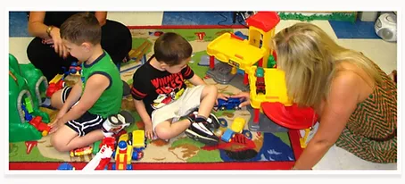
At school we will have lots of fun activities such as circle time and play time.

Slide 8
We will do arts and crafts!

Slide 9
Soccer Shots visits our school sometimes!!

Slide 10
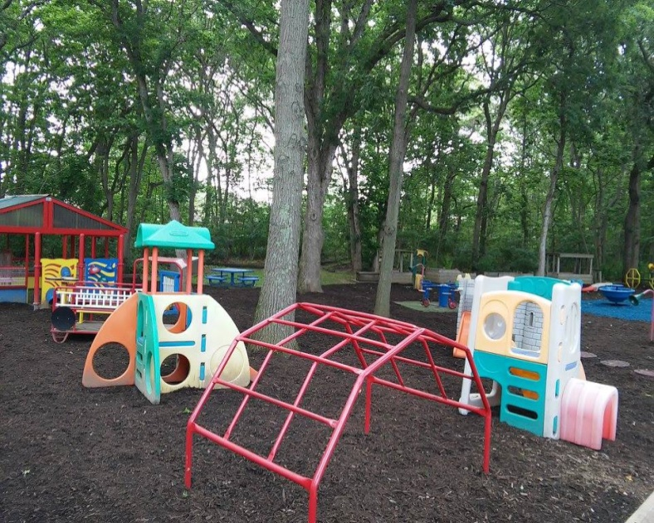
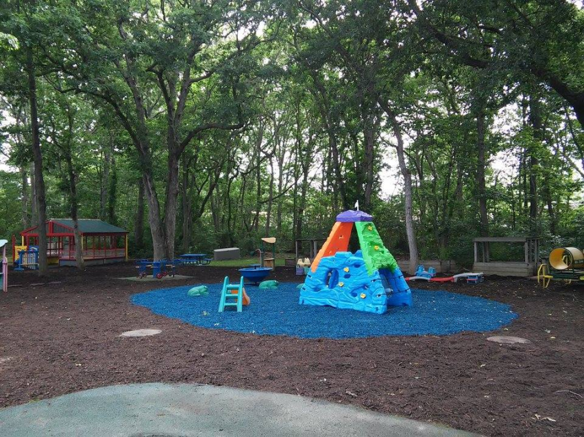
We will have fun on the playground!!

Slide 11
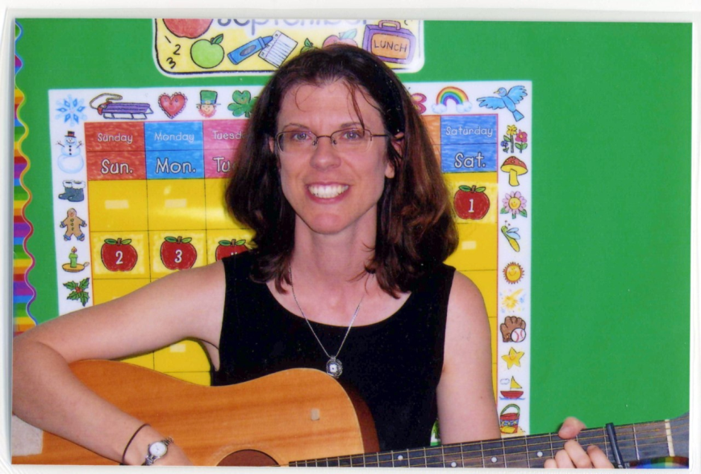
Miss Margie will visit our class sometimes for music.

Slide 12
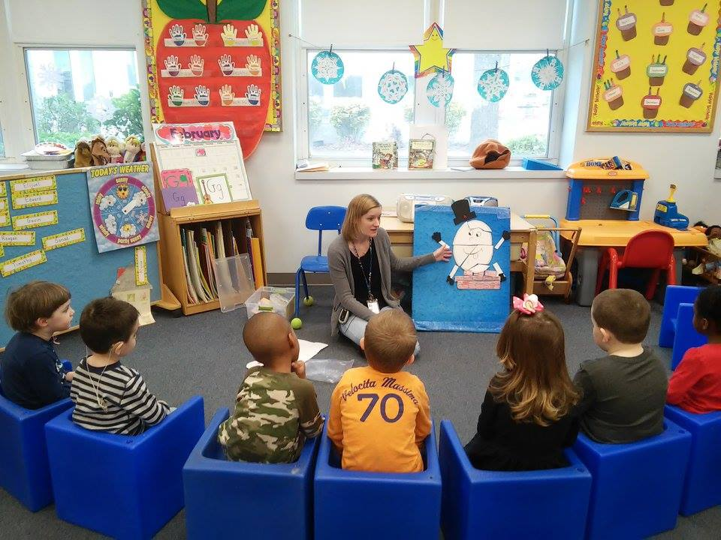
Miss Danielle will visit our class for Little Stars. We will learn about feelings.

Slide 13
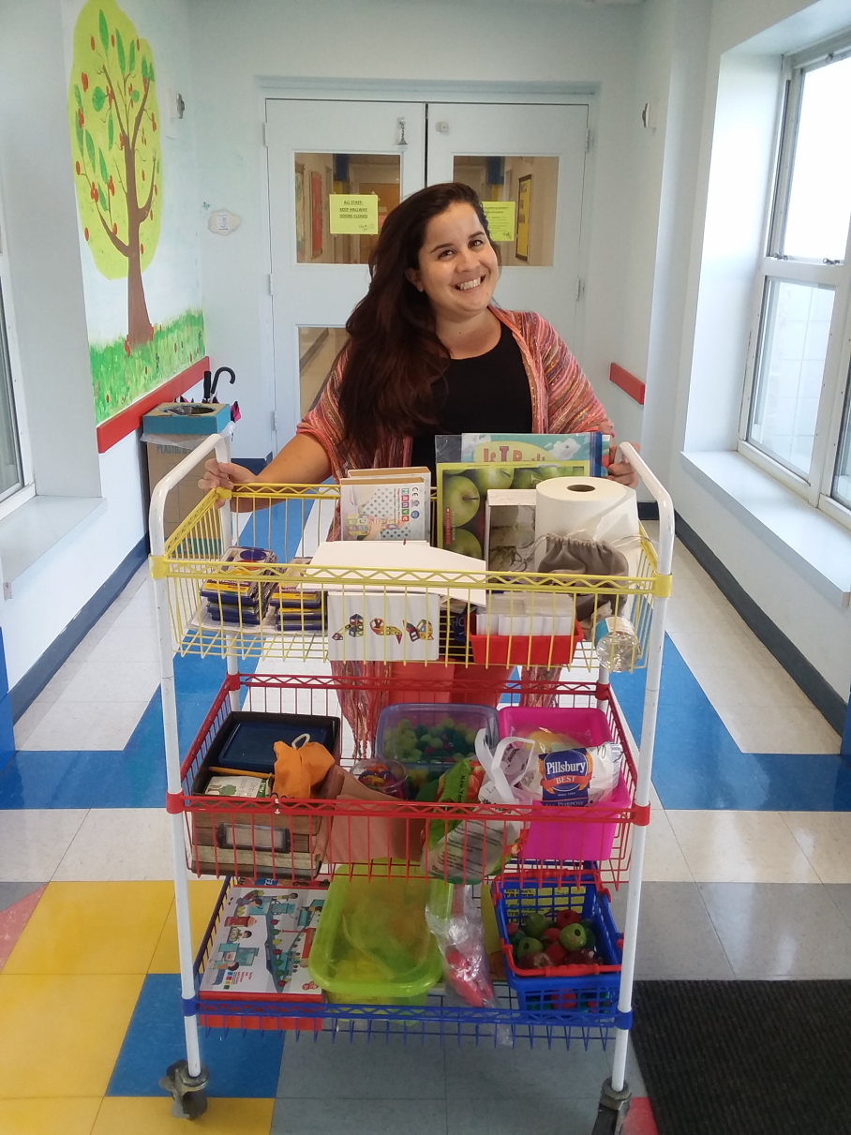
Miss Athena will visit our classroom for STEAM.

Slide 14
I will have speech therapy.

Slide 15
I will go to Occupational Therapy.

Slide 16
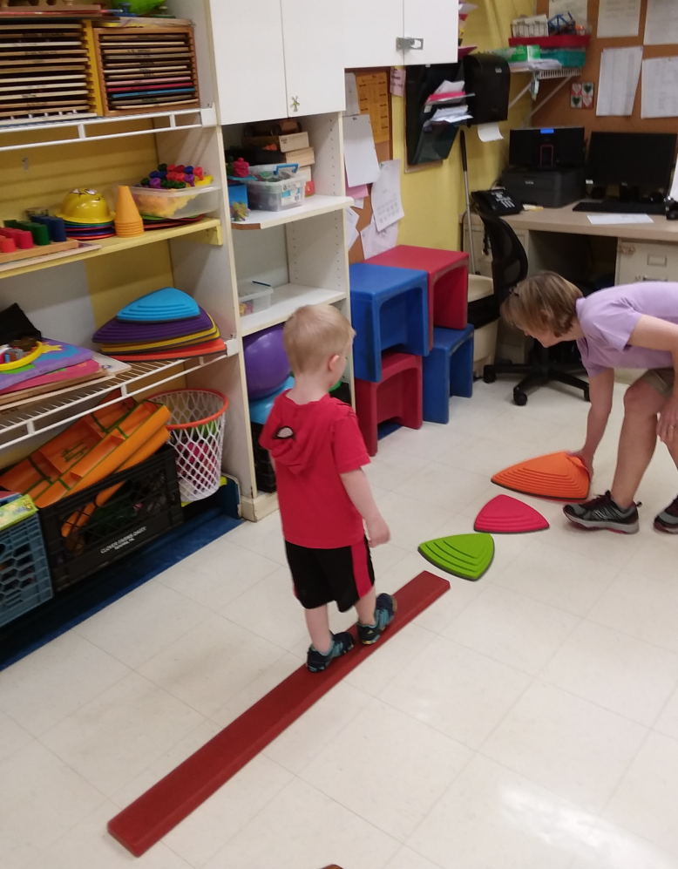
I will go to Physical Therapy.

Slide 17
I will go to play therapy.

Slide 18
Of course we will have snack and lunch.

Slide 19
When our day is over, it is time to go home and see my family!

